Slide 1
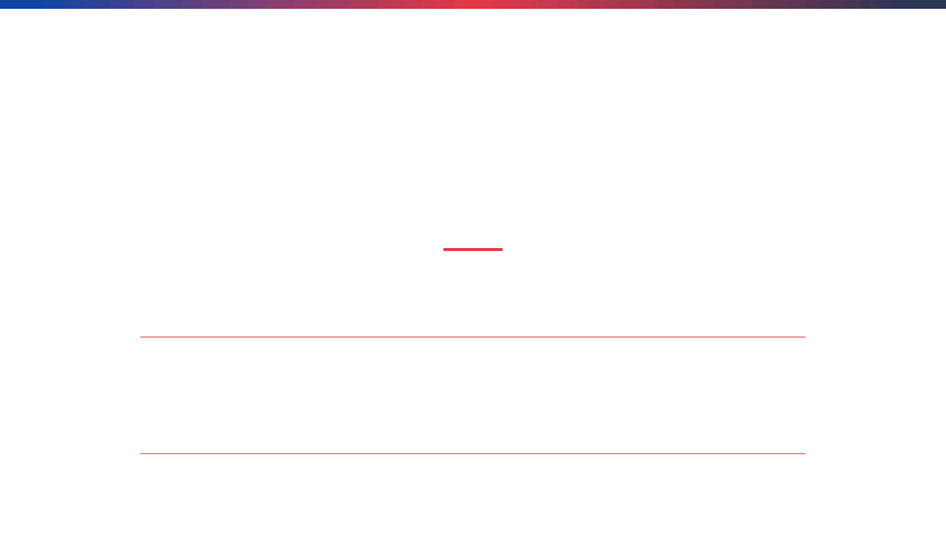
Chapter 7
Information Management and Digital Literacy for Science Teachers
Computing Science for Science Teaching
Author and Affiliation
Faculty of Education
Department of Science Education
University of Science and Technology
English Title: Computing Science for Science Teaching
Thai Title: วิทยาการคำนวณสำหรับการสอนวิทยาศาสตร์
Notes:
We are beginning Chapter 7, which shifts our focus from the theoretical underpinnings of computational thinking to the practical skills of information management and digital literacy, which are crucial for every science teacher. This chapter emphasizes that integrating computing science into teaching requires not just understanding algorithms, but also mastering the digital environment where modern science operates. We recognize that today's scientific research is fundamentally digital, generating massive amounts of data that must be handled responsibly and efficiently. For us as educators, this means we must model and teach these essential digital competencies to our students, preparing them for a world where scientific inquiry is inseparable from digital tools. This foundational knowledge ensures that we can effectively manage our own professional resources and guide students in managing their scientific data. We will now delve into the first critical topic within this chapter: the absolute necessity of effective data management in the context of scientific work.

Slide 2

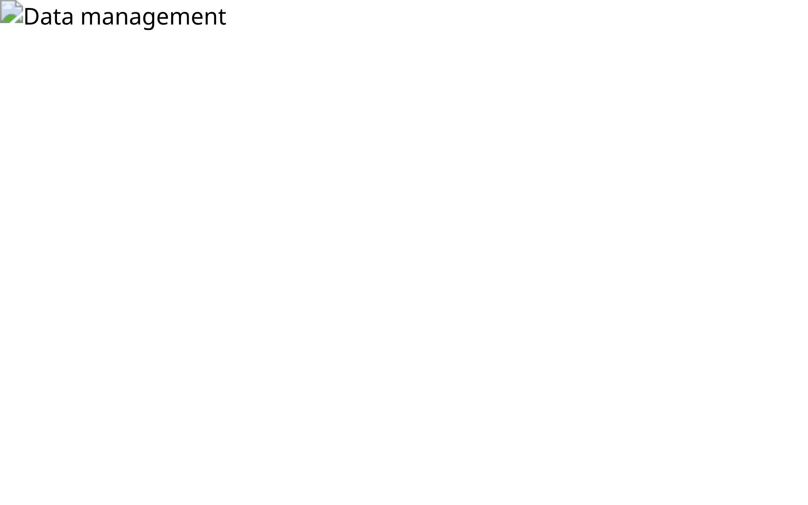
The Importance of Data Management in Science
Effective data management is crucial for scientific reproducibility, collaboration, and long-term research impact. For science educators, teaching students how to organize and manage data is as important as teaching them how to collect it.
Notes:
The integrity of modern science hinges on effective data management, making it a non-negotiable skill for both researchers and students. Data management is not merely an administrative task; it is a core component of scientific rigor that ensures our findings are reproducible and trustworthy. When we teach students to manage data well, we are teaching them responsibility, precision, and the ethics of scientific documentation. Poor data management can lead to irreproducible results, wasted resources, and ultimately, a loss of scientific credibility. We must emphasize that the process of organizing, storing, and preserving data is just as vital as the process of collecting it in the first place. Therefore, our role is to transition students from simply recording observations to systematically curating digital evidence. This focus on systematic curation leads us directly to the fundamental principles that govern how we organize scientific data.

Slide 3

Principles of Data Organization
Good data organization starts with a systematic approach from the outset of any scientific project.
1. Consistent Naming Conventions
Establish clear, descriptive, and consistent file and folder naming conventions that make data easy to locate and understand.
2. Logical Folder Structures
Create a hierarchical folder structure that logically groups related files, facilitating navigation and preventing data loss.
3. Metadata Documentation
Metadata is "data about data"—information describing the context, content, and structure of a dataset.
Notes:
Good data organization is the bedrock of efficient and reproducible science, demanding a systematic approach from the very start of any project. The first principle involves establishing consistent naming conventions, which means moving beyond generic names like "data_final" to using descriptive, standardized formats that include key information like date, experiment, and variable. Next, we must implement a logical folder structure, creating a hierarchical system that mirrors the scientific process itself, making it easy to locate specific datasets years later. Perhaps the most critical principle is the use of metadata, which is the contextual information that makes the raw data meaningful. Metadata documents the "who, what, when, where, and how" of the data collection, ensuring that others—or even our future selves—can fully understand and reuse the dataset. These three principles transform a chaotic collection of files into a structured, accessible scientific asset. These organizational principles are formalized and planned out in a critical document we call the Data Management Plan.

Slide 4

Data Management Plans (DMPs)
A Data Management Plan (DMP) is a formal document that outlines how data will be collected, organized, stored, preserved, and shared throughout a research project and beyond.
Why DMPs Matter: Many funding agencies now require DMPs; they encourage proactive thinking about data management from the project's outset.
Notes:
A Data Management Plan, or DMP, is a proactive strategy that formalizes how scientific data will be handled throughout its entire lifecycle, from collection to long-term preservation. The creation of a DMP forces researchers and students to think critically about data management before the project even begins, anticipating potential challenges and establishing clear protocols. This is no longer optional; many major funding agencies now require a detailed DMP, recognizing that responsible data stewardship is essential for public investment in science. A well-constructed DMP addresses questions about data standards, access policies, security, and archiving, ensuring transparency and maximizing the potential for data sharing. By teaching students to draft DMPs, we instill a professional mindset that views data as a valuable, long-term asset, not just a temporary collection of numbers. A key component of any robust DMP is the strategy for protecting that valuable data, which brings us to the topic of storage and backup.

Slide 5
Data Storage, Backup, and Redundancy
Core Principle: Never rely on a single copy of data. Implement a robust backup strategy to protect against data loss.
3
2
1
Three Copies of important data
Two Media types for storage
One Offsite copy for disaster recovery
Notes:
Protecting scientific data requires a robust strategy centered on the core principle that we must never rely on a single copy of any important file. The industry standard for data protection is often summarized by the 3-2-1 rule, which provides a simple yet powerful framework for ensuring redundancy and resilience against data loss. This rule mandates keeping three copies of your data: the primary copy and two backups. These copies should be stored on at least two different types of media, such as a local hard drive and a cloud service, to guard against media-specific failures. Crucially, one of those copies must be stored offsite, meaning physically separated from the primary location, which protects against catastrophic local events like fire or theft. Implementing this 3-2-1 strategy minimizes the risk of losing irreplaceable research data, safeguarding the integrity and continuity of scientific work. Now that we have covered how to organize and protect data, we must also consider the ethical and legal dimensions of handling sensitive information.

Slide 6


Data Security and Privacy
Scientific data often contains sensitive information that requires protection from unauthorized access and misuse.
Key Security Practices: Access Control, Encryption, Authentication, Audit Trails, Regular Updates
Notes:
Data security and privacy are not just technical issues; they are ethical and legal responsibilities inherent in handling scientific data. Scientific data often contains sensitive information, whether it is proprietary research findings, confidential patient data in medical studies, or even location data from environmental sensors. We must protect this information from unauthorized access and misuse. A robust security posture relies on several key practices. Access control ensures only authorized personnel can view or modify data, while encryption scrambles the data, making it unreadable even if intercepted. Furthermore, authentication verifies user identities, and audit trails provide a record of who accessed what and when, which is crucial for accountability. We must also commit to regular system updates to patch vulnerabilities. Failing to secure data can compromise research integrity, violate privacy laws, and erode public trust in science. Now that we have established the necessity of protecting data, let us consider the movement toward making non-sensitive data more accessible to the public.

Slide 7


Open Science and Data Sharing
Open science is the practice of making research processes and outputs openly available for scrutiny and reuse, promoting transparency, reproducibility, and collaborative advancement of scientific knowledge.
Notes:
Open science represents a fundamental shift in how we conduct and disseminate research, moving toward greater transparency and collaboration. This practice involves making research processes and outputs—including data, methods, and publications—openly available for scrutiny and reuse. The core goal is to promote reproducibility, which is the bedrock of scientific credibility. When data is shared openly, other researchers can validate findings, build upon existing work more efficiently, and accelerate the pace of discovery. This collaborative approach minimizes duplication of effort and maximizes the societal return on research investment. However, open science must be balanced carefully with the security and privacy concerns we just discussed. We must ensure that any shared data is anonymized and stripped of sensitive identifiers before being made public. Embracing open science principles in the classroom prepares students for the future of research. Next, we will explore the broader set of skills necessary for teachers to navigate this increasingly digital scientific landscape.

Slide 8
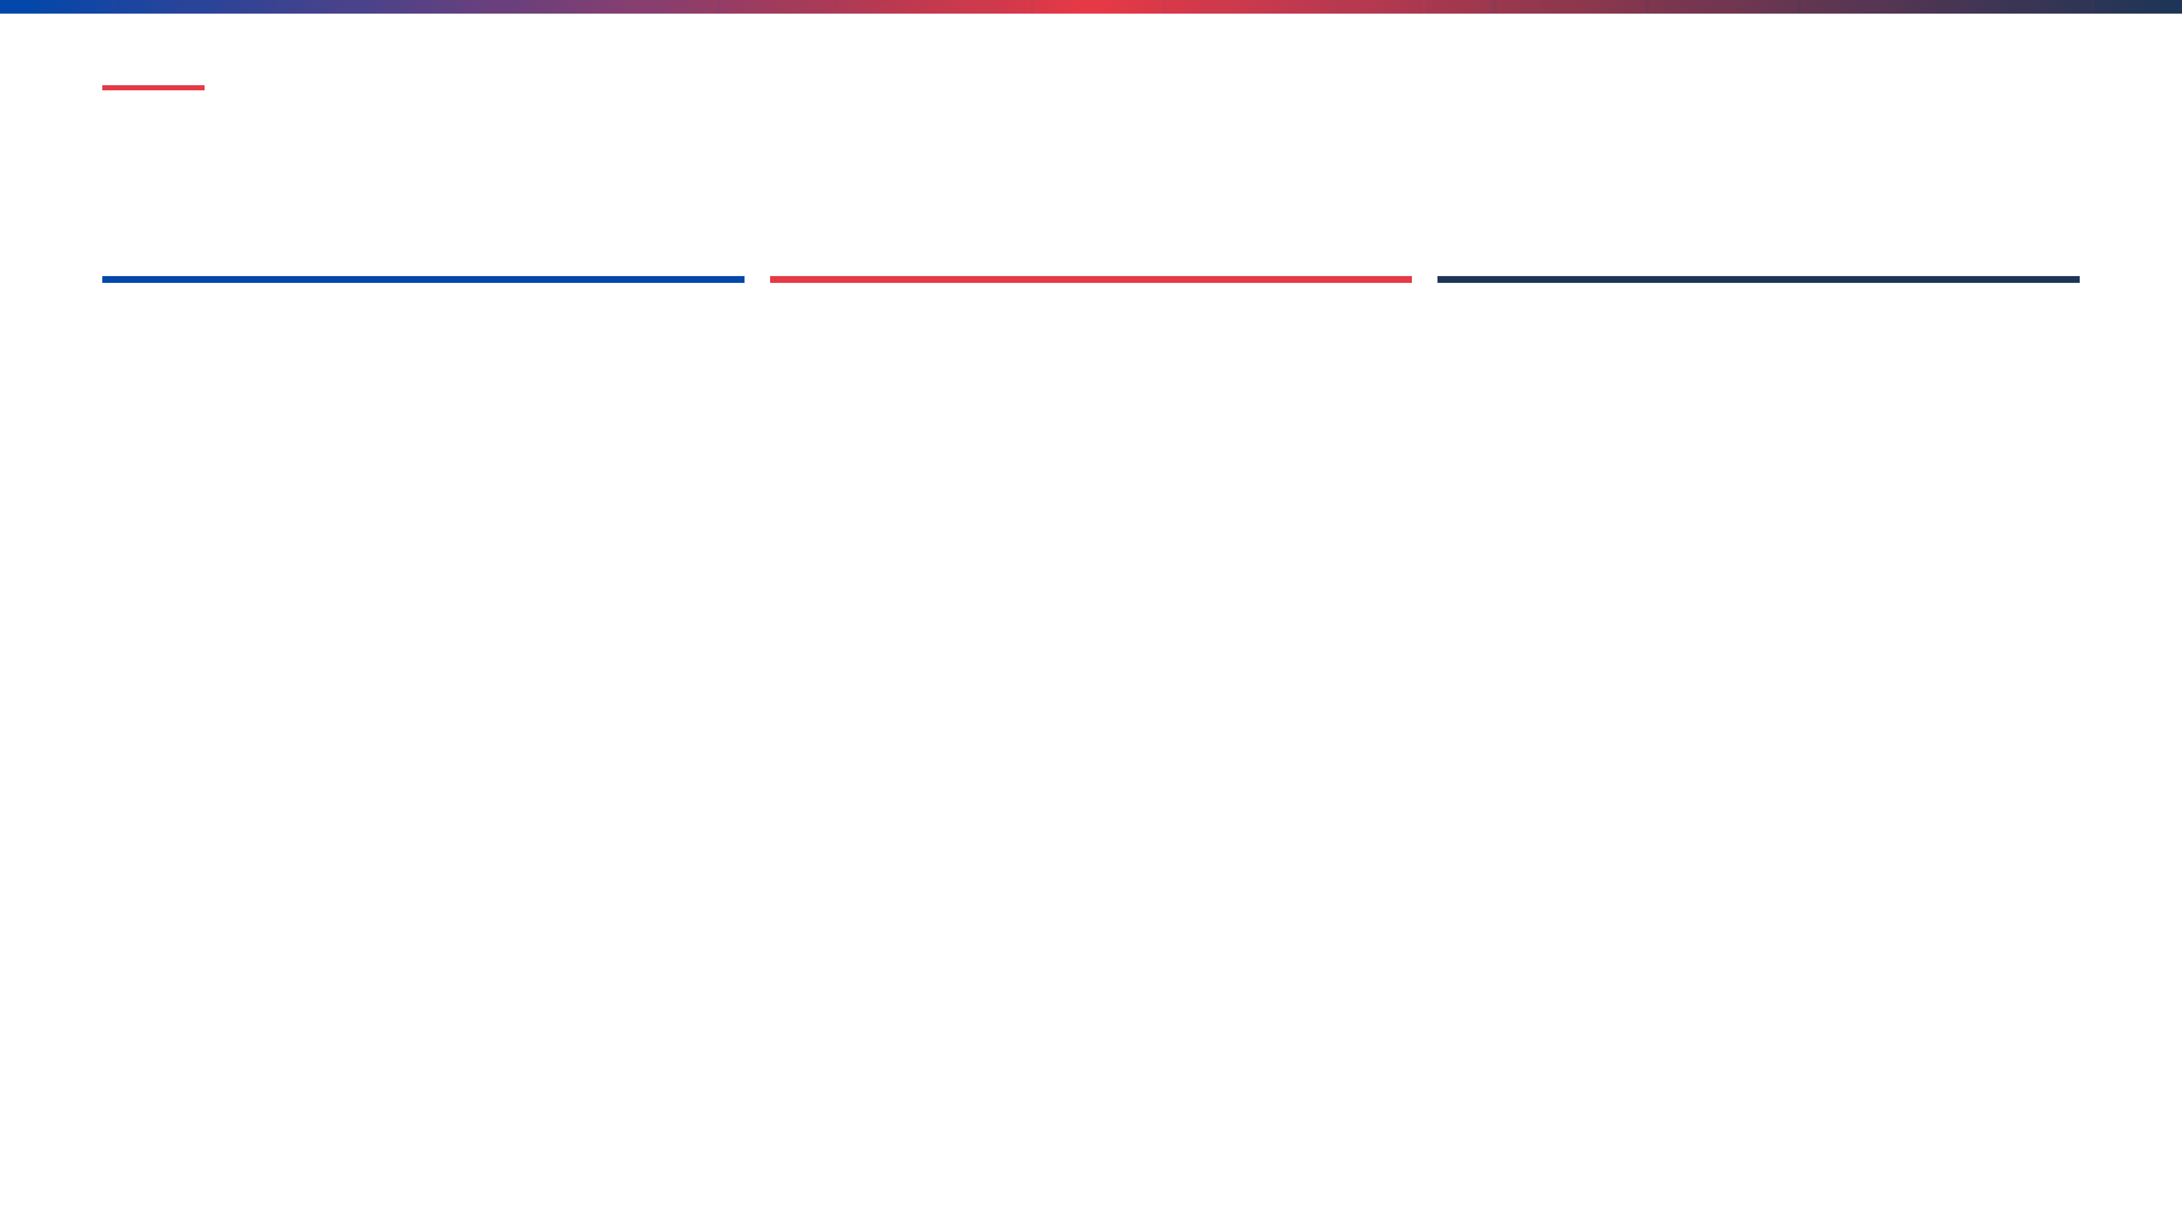
Digital Literacy for Science Teachers: 3 Practical Teaching Strategies
Implementable approaches to develop digital literacy skills in science classrooms
Strategy 1: Data Management Project-Based Learning
Strategy 2: Digital Source Evaluation Workshop Series
Strategy 3: Cybersecurity & Data Protection Simulation
Students engage in semester-long projects collecting, organizing, and analyzing real scientific data. They create folder structures, document metadata, and share findings in open repositories.
Structured workshops teaching AACRAO criteria (Authority, Accuracy, Objectivity, Currency, Purpose) for evaluating online scientific information and distinguishing credible sources from misinformation.
Interactive scenarios where students respond to realistic cybersecurity challenges: phishing emails, lost devices, data breaches, and ransomware attacks. Students develop incident response plans.
Learning Outcomes:
Learning Outcomes:
Learning Outcomes:
• Practical data management skills
• Understanding of research data lifecycle
• Experience with real scientific workflows
• Effective communication of findings
• Critical thinking skills
• Ability to identify misinformation
• Knowledge of reliable sources
• Resistance to pseudoscience
• Cybersecurity threat awareness
• Practical security decision-making
• Understanding of incident response
• Personal security habits
Notes:
Digital literacy is no longer optional for science teachers; it is a prerequisite for effective instruction in the modern era. We can empower students by integrating practical strategies that build these essential skills directly into the science curriculum. Consider Strategy 1, Data Management Project-Based Learning, where students actively engage in the entire research data lifecycle. They learn to organize data, document metadata, and understand the practical workflows of real science, moving beyond simply analyzing a clean dataset. Strategy 2 focuses on critical evaluation through a Digital Source Evaluation Workshop Series. By teaching students criteria like Authority, Accuracy, and Purpose, we equip them to distinguish credible scientific sources from the vast amount of misinformation online. Finally, Strategy 3 uses a Cybersecurity and Data Protection Simulation to build practical awareness. These interactive scenarios teach students how to respond to real-world threats like phishing or data breaches, instilling crucial personal security habits. These three strategies provide concrete, actionable ways to integrate digital literacy into your existing science lessons. This focus on critical evaluation leads us directly to our next topic, which details the specific criteria for assessing online scientific information.

Slide 9
Evaluating Scientific Information Online
Challenge: The vast amount of information available online makes it difficult to distinguish credible scientific information from misinformation and pseudoscience.
Five Criteria for Evaluating Sources
Authority, Accuracy, Objectivity, Currency, Purpose
Red Flags for Misinformation
Sensational language, extraordinary claims without evidence, lack of citations, ad hominem attacks, conspiracy theories
Notes:
The sheer volume of information available online presents a significant challenge to scientific literacy, making the ability to evaluate sources a critical skill. Our goal is to equip students with the tools to distinguish credible scientific information from pervasive misinformation and pseudoscience. We can simplify this process by focusing on five key criteria for source evaluation: Authority, Accuracy, Objectivity, Currency, and Purpose. Authority asks who created the content and what their credentials are. Accuracy examines whether the information is supported by evidence and peer review. Objectivity assesses bias, while Currency checks the timeliness of the data. Finally, Purpose reveals the motivation behind the content's creation. Beyond these criteria, we must teach students to recognize common red flags for misinformation. These include sensational language, extraordinary claims lacking evidence, the absence of citations, and the use of ad hominem attacks. By teaching students to apply these criteria and recognize these flags, we foster a generation of scientifically skeptical and digitally savvy citizens. This critical evaluation skill is intrinsically linked to understanding the importance of data security, which we will discuss next.

Slide 10

Cybersecurity and Data Protection: Top 5 Threats to Scientific Data
1
Ransomware Attacks
Malicious software encrypts files and systems, with attackers demanding payment for decryption keys. Attacks have increased 300% on research institutions.
Key Mitigation:
3-2-1 backups, access controls, email security, software updates, incident response planning
2
Phishing and Social Engineering
Attackers impersonate trusted entities to trick users into revealing credentials or clicking malicious links. 30-40% of phishing emails are opened.
Key Mitigation:
Email authentication (SPF, DKIM, DMARC), phishing detection, user training, multi-factor authentication, verification procedures
3
Insider Threats and Unauthorized Access
Malicious or negligent actions by authorized users with legitimate system access. Difficult to detect due to trusted access privileges.
Key Mitigation:
Principle of least privilege, access monitoring, data loss prevention, background checks, separation of duties, exit procedures
4
Data Breaches and Unauthorized Disclosure
Unauthorized access to and disclosure of sensitive research data, including personal information and proprietary research findings.
Key Mitigation:
Data encryption, strong authentication, regular audits, data minimization, secure disposal, vendor assessment, cyber insurance
5
Supply Chain Attacks and Third-Party Vulnerabilities
Attackers compromise software vendors or services, affecting thousands of organizations through legitimate updates. SolarWinds attack affected 18,000+ organizations.
Key Mitigation:
Vendor security assessment, dependency management, careful update testing, network segmentation, monitoring, incident response procedures
Notes:
We've established the importance of evaluating information, but that information is only useful if it is secure and protected. Cybersecurity is no longer just an IT problem; it is a critical concern for scientific integrity and data reliability. We must understand the top threats to scientific data because research institutions are increasingly targeted due to the value of their intellectual property. Ransomware attacks, for instance, can halt critical research for weeks, and these attacks have increased dramatically against our sector. We mitigate this by implementing robust strategies like the 3-2-1 backup rule and ensuring all software is patched immediately. Phishing remains the most common entry point, exploiting human trust to gain access, which is why multi-factor authentication and continuous user training are non-negotiable requirements. Finally, we must recognize that threats can come from within, either maliciously or through negligence, necessitating the principle of least privilege and careful monitoring of access. Protecting our data is fundamental to maintaining the public trust in science. Now, let's broaden this discussion to the ethical framework that governs all our digital interactions.

Slide 11

Digital Citizenship and Responsible Technology Use
Digital citizenship encompasses the norms of appropriate, responsible behavior with regard to technology use in science education.
Ethical Data Handling
Online Collaboration
Collecting, storing, and sharing data ethically while protecting participant privacy
Participating respectfully and productively in online scientific communities
Intellectual Property
Critical Evaluation
Respecting copyright, providing attribution, and understanding licensing
Discerning credible scientific information from misinformation
Notes:
Moving from the technical aspects of data protection, we now focus on the human element: how we should behave in the digital scientific sphere. Digital citizenship defines the norms for appropriate and responsible technology use, ensuring that our digital actions uphold the integrity of the scientific process. Ethical data handling is paramount; we must prioritize participant privacy and ensure that data collection and storage adhere to all regulatory and ethical guidelines. Furthermore, responsible online collaboration means participating respectfully in scientific communities, recognizing that our digital footprint reflects on our institutions and our profession. This also includes strict adherence to intellectual property rights, giving proper attribution, and understanding licensing requirements for shared resources. Ultimately, good digital citizenship requires the critical evaluation skills we discussed earlier, enabling us to discern credible scientific information from the noise of misinformation. These ethical considerations form the foundation for how we integrate these skills into our teaching practice.

Slide 12

Integrating Information Management and Digital Literacy into Science Teaching
1
2
Data management and digital literacy are essential skills for modern science education
Teaching these skills requires modeling good practices and providing hands-on experience
3
4
Critical evaluation of digital information protects against misinformation
Responsible use of technology promotes scientific integrity and ethical practice
Integrate information management and digital literacy into your science curriculum to prepare students for contemporary scientific practice.
Notes:
We have covered the necessary components of digital literacy, from evaluating sources to practicing good digital citizenship, and now we bring it all together. Integrating information management and digital literacy is not an add-on; it is an essential component of preparing students for contemporary scientific practice. These skills must be explicitly taught and modeled by educators, not just assumed, requiring us to demonstrate good practices in our own data handling and technology use. We must emphasize that the critical evaluation of digital information is the first line of defense against the spread of misinformation, which can undermine scientific understanding. Furthermore, teaching the responsible use of technology reinforces scientific integrity and ethical practice, preparing students to be trustworthy researchers. We must embed these concepts directly into our science curriculum to ensure students are equipped to navigate the data-rich world of modern science. This concludes our discussion on information management and digital literacy. Thank you for your engagement.

